Slide 1
AI Expert 프로그램 실습
9/11 Graphical Models, Gaussian Process, Hawkes Process

Slide 2
Part 3. Hawkes Process
Overview
Point Process
Poisson Process
Hawkes Process
Predicting Retweet Dynamics
* This part refers to the ICML 2018 tutorial Learning with Temporal Point Processes (Rodriguez and Valera, 2018)
* Also, predicting Retweet dynamics refers to TideH (Kobayashi and Lambiotte, 2016).

Slide 3
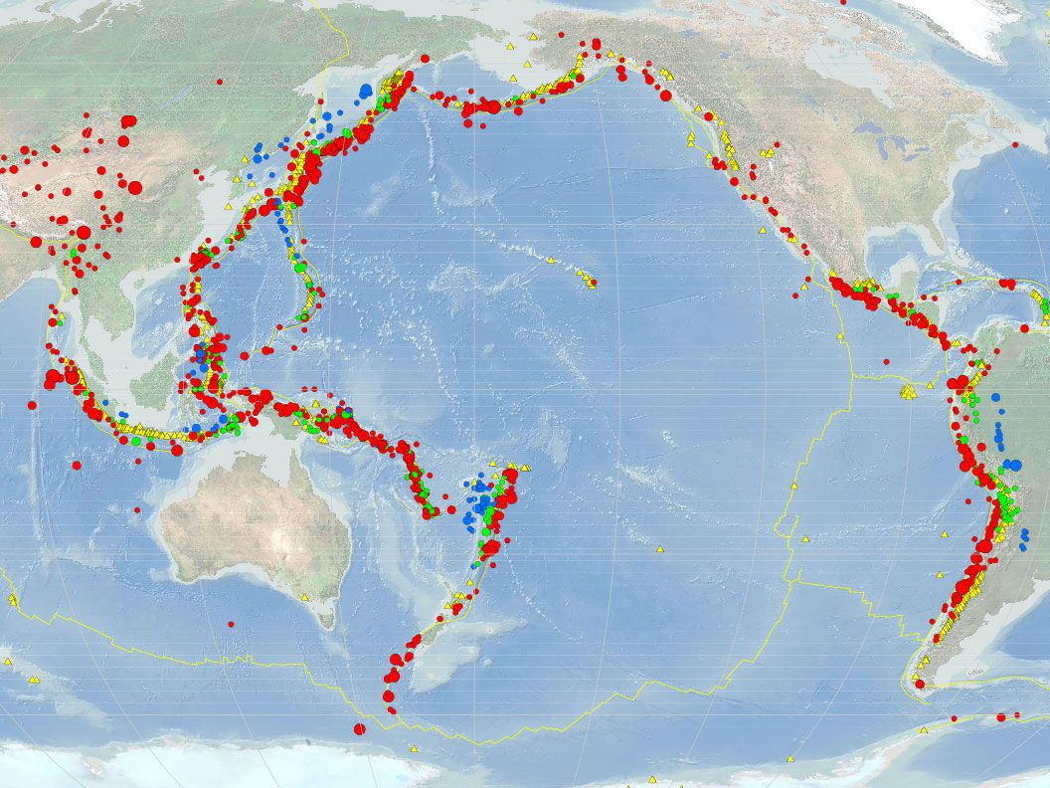

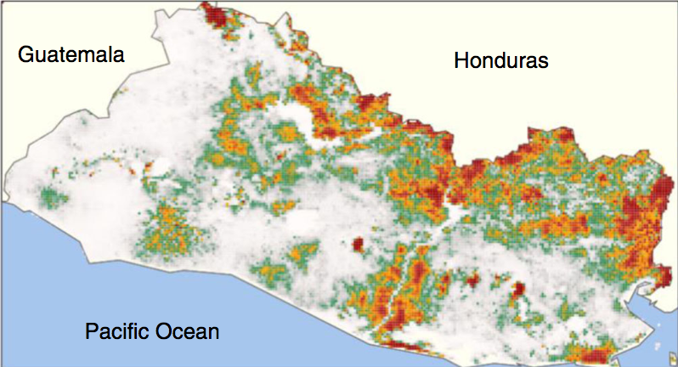
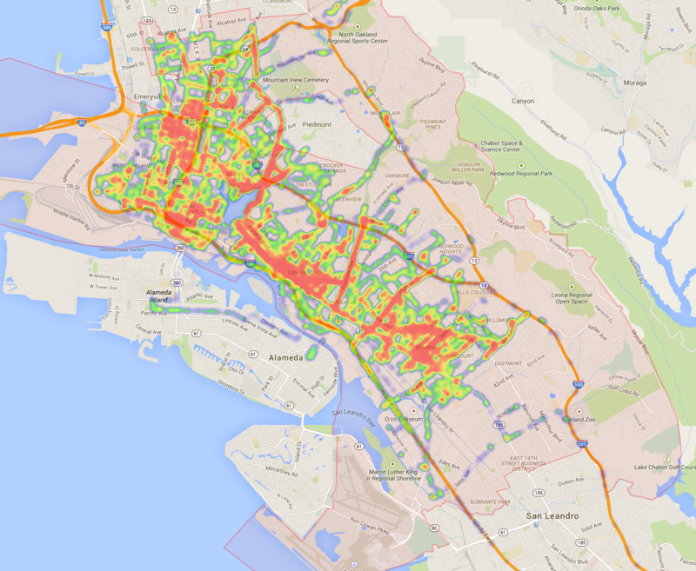

Part 3. Hawkes Process
Many discrete events in continuous time !
Earthquake
Online actions
Disease dynamics
Financial trading
Mobility dynamics

Slide 4







Part 3. Hawkes Process
Variety of processes behind these events
Stock trading
Flu spreading
Article creation in Wikipedia
News spread in Twitter
Reviews and sales in Amazon
A user’s reputation in Quora
Ride-sharing requests
Fast
Slow
…in a wide range of temporal scales.

Slide 5
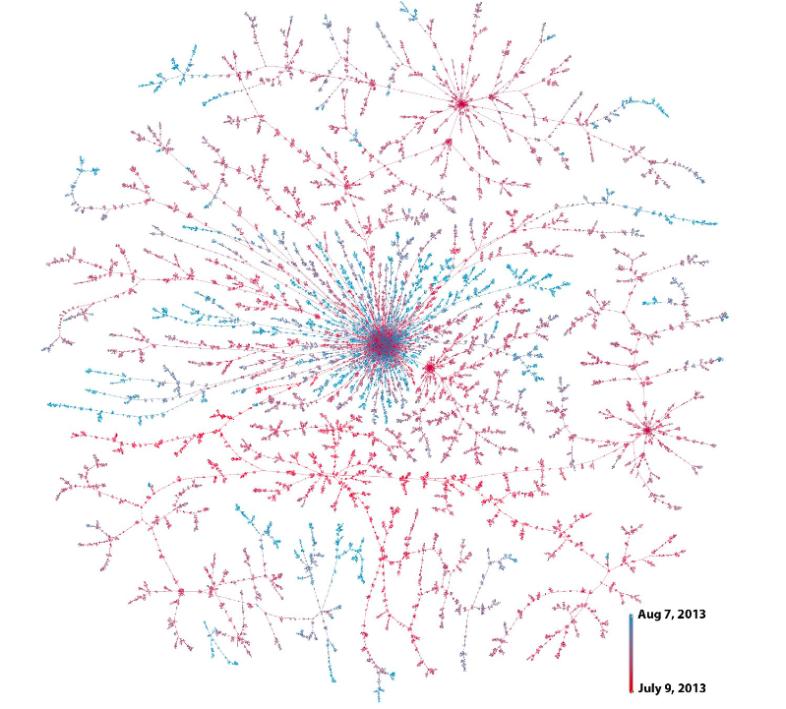





Part 3. Hawkes Process
Real World Examples
S
D
Christine
means
3.00pm
D follows S
Bob
3.25pm
Beth
3.27pm
Joe
David
Friggeri et al., 2014
4.15pm

Slide 6
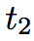
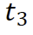
Part 3. Hawkes Process
Temporal point process is a random process whose realization consists of discrete events localized in time
Discrete events
$$N\left(t\right)∈\left\{0\right\}∪ℤ^{+}$$
time
History, $ℋ(t)$
$$dN\left(t\right)∈\left\{0,1\right\}$$
Dirac delta function
Formally: $N\left(t\right)=\int_{0}^{t}{dN(s)}$
$$dN\left(t\right)=\sum_{t_{i}∈ℋ(t)}{δ\left(t−t_{i}\right)dt }$$

Slide 7
Part 3. Hawkes Process
Temporal Point process can be represented as Intensity function
$$N(t)$$
time
t₁
t₂
t₃
History $ℋ(t)$
Since it is cumbersome to model event counts over time, we model event intensity over time.
$$λ^{∗}\left(t\right)dt=𝔼\left[dN\left(t\right) | ℋ\left(t\right)\right]$$
It is a rate = # of events / unit of time
Notes:
λ∗(t) is expected value of (infinitesimal) change in event count over time, given event history
⇔ λ∗(t) is number of events per time interval, and this changes over time!

Slide 8
Part 3. Hawkes Process
Poisson process
$$N(t)$$
time
t₁
t₂
t₃
t
Intensity of a Poisson process
$$λ^{∗}\left(t\right)=μ$$
Observations:
Intensity independent of history
Uniformly random occurrence
Time interval follows exponential distribution

Slide 9
Part 3. Hawkes Process
Hawkes process: Self-exciting intensity function
time
t₁
t₂
t₃
History 𝓗(t)
Self-exciting: each arrival increase the rate of future arrivals for some period
Intensity of Hawkes process:
$$λ^{∗}\left(t\right)=μ+α\sum_{t_{i}<t}{φ(t−t_{i})}$$
Baseline
Triggering kernel
Observations:
Clustered (or bursty) occurrence of events
Intensity is stochastic and history dependent

Slide 10
Part 3. Hawkes Process
Tick: Python Library for statistical learning about point processes
How to Install
cogito@digits-1:~$ pip install tick
cogito@digits-1:~$ pip install –-upgrade scipy==1.0.0 # optional
cogito@digits-1:~$ pip install dill # optional
Notes:
- Tick 깔았는데 아래 에러 나면, pip install –upgrade scipy
ImportError: cannot import name 'comb‘
Kernels for Hawkes process simulation
A Hawkes process is defined through its kernels which are functions defined on [0,∞).

Slide 11
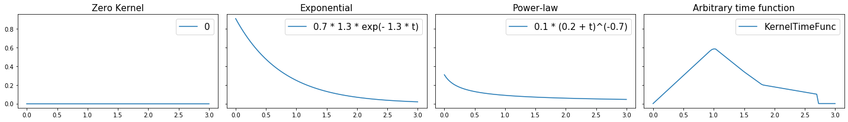
Part 3. Hawkes Process
Tick: Python Library for statistical learning about point processes
How to Use - Simulation
from tick.hawkes import HawkesKernel0, HawkesKernelExp, HawkesKernelPowerLaw, HawkesKernelTimeFunc
...
kernel_exp = HawkesKernelExp(.7, 1.3) # HawkesKernelExp(intensity, decay)
t_values = np.linspace(0, 3, 100)
kernel_exp.get_values(t_values)) # Simulation using get_values([times])
Let’s run the sample code !
Notes:
- Tick 깔았는데 아래 에러 나면, pip install –upgrade scipy
ImportError: cannot import name 'comb‘
Kernels for Hawkes process simulation
A Hawkes process is defined through its kernels which are functions defined on [0,∞).

Slide 12
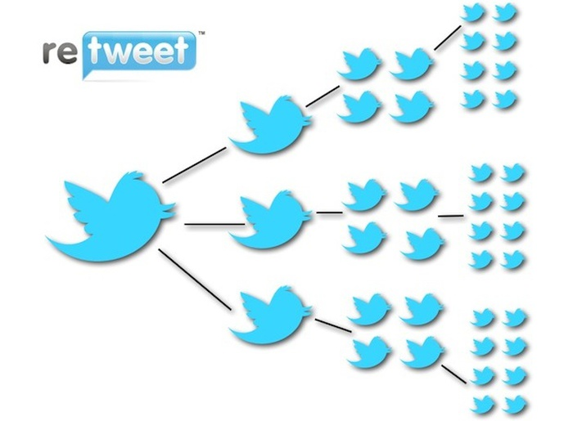


Part 3. Predicting Retweet Dynamics using Hawkes Process
Predicting Retweet Dynamics using Hawkes Process
time
t₁
t₂
t₃
t₄
t₆
Kobayashi, R., & Lambiotte, R. (2016, March). Tideh: Time-dependent hawkes process for predicting retweet dynamics. In Tenth International AAAI Conference on Web and Social Media.

Slide 13
Part 3. Predicting Retweet Dynamics using Hawkes Process
Get ready for the codes!
https://github.com/NII-Kobayashi/TiDeH
cogito@digits-1:~$ git clone https://github.com/NII-Kobayashi/TiDeH
Cloning into 'TiDeH'...
remote: Enumerating objects: 132, done.
remote: Total 132 (delta 0), reused 0 (delta 0), pack-reused 132
Receiving objects: 100% (132/132), 1.61 MiB | 310.00 KiB/s, done.
Resolving deltas: 100% (9/9), done.
Checking connectivity... done.
cogito@digits-1:~$ cd TiDeH/
파일 소스 트리
Kobayashi, R., & Lambiotte, R. (2016, March). Tideh: Time-dependent hawkes process for predicting retweet dynamics. In Tenth International AAAI Conference on Web and Social Media.

Slide 14
Part 3. Predicting Retweet Dynamics using Hawkes Process
What you will see is …
TiDeH/
| data/
| | example/
| | | sample_file.txt*
| | training/
| tideh/
| | __init__.py*
| | estimate.py*
| | fit.py*
| | functions.py*
| | main.py*
| | prediction.py*
| | simulate.py*
| | training.py*
| example_native.py*
| example_optimized.py*
| example_simulation.py*
| example_training.py*
2150 160.627488
0.000000 503173
0.000021 133
0.000324 40
0.000910 73
0.003047 83
0.003141 30
0.003451 15
0.003552 305
0.003970 208
0.006932 82
0.006984 287
0.007528 124
0.007718 100
0.008874 17
0.008999 77
0.009056 101
0.009210 28
* one file per tweet
* space separated
* only tweets with more than 2000 retweets were used
First row
<number of total retweets>
<start time of tweet in days>

Slide 15

Part 3. Predicting Retweet Dynamics using Hawkes Process
What you will see is …
TiDeH/
| data/
| | example/
| | | sample_file.txt*
| | training/
| tideh/
| | __init__.py*
| | estimate.py*
| | fit.py*
| | functions.py*
| | main.py*
| | prediction.py*
| | simulate.py*
| | training.py*
| example_native.py*
| example_optimized.py*
| example_simulation.py*
| example_training.py*
2150 160.627488
0.000000 503173
0.000021 133
0.000324 40
0.000910 73
0.003047 83
0.003141 30
0.003451 15
0.003552 305
0.003970 208
0.006932 82
0.006984 287
0.007528 124
0.007718 100
0.008874 17
0.008999 77
0.009056 101
0.009210 28
* one file per tweet
* space separated
* only tweets with more than 2000 retweets were used
First row
<number of total retweets>
<start time of tweet in days>
Every other row
<relative tweeted/retweeted time in seconds> <number of followers of retweeting person>
time
Actual time
0.500
Original Tweet
t = 0
Follower: 90
Retweet
t = 292
Follower: 43344

Slide 16
Part 3. Predicting Retweet Dynamics using Hawkes Process
How to run the example code
cogito@digits-1:~/TiDeH$ python3 example_native.py
Example of predicting future retweet activity. Given an observation time, the parameters of the infectious rate are estimated and then, the number of retweets before a given time is predicted.
Then, you will see the results
Estimated parameters are:
p0: 0.001
r0: 0.414
phi0: 0.140
tm: 1.822
Average % error (estimated to fitted): 12.33
Predicted number of retweets from 48 to 168 hours: 37
Predicted number of retweets at hour 168: 2170
Prediction error (absolute): 20

Slide 17
Part 3. Predicting Retweet Dynamics using Hawkes Process
How to run the example code
Let’s look at the code example_native.py
# Module import
from tideh import estimate_parameters
from tideh import load_events
from tideh import predict
# Read dataset
filename = 'data/example/sample_file.txt'
(_, start_time), events = load_events(filename)
Notes:
$p\left(t\right)$: infectious rate
$t_{i}$: the time of i-th retweet
$d_{i}$: followers of the i-th retweeting person
$φ\left(⋅\right)$: exciting kernel, a probability distribution for the time interval between a tweet by the followee and its retweet by the follower.

Slide 18
Part 3. Predicting Retweet Dynamics using Hawkes Process
How to run the example code
Let’s look at the code example_native.py
# additional parameters passed to infectious rate function
add_params = {'t0': start_time, 'bounds': [(-1, 0.5), (1, 20.)]}
obs_time = 48 # observation time of 2 days
pred_time = 168 # predict for one week
params, err, _ = estimate_parameters(events=events, obs_time=obs_time, **add_params)
The probability for getting a retweet in a small-time interval $\left[t,t+∆t\right]$ is $λ\left(t\right)∆t.$
$$λ\left(t\right)=p(t)\sum_{i:t_{i}<t}{d_{i}φ(t−t_{i})}$$
Exciting kernel
Infectious
rate
# Followers
Notes:
$p\left(t\right)$: infectious rate
$t_{i}$: the time of i-th retweet
$d_{i}$: followers of the i-th retweeting person
$φ\left(⋅\right)$: exciting kernel, a probability distribution for the time interval between a tweet by the followee and its retweet by the follower.

Slide 19
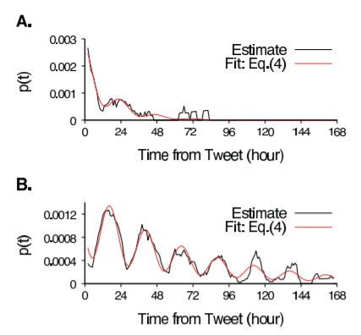
Part 3. Predicting Retweet Dynamics using Hawkes Process
How to run the example code
Let’s look at the code example_native.py
# additional parameters passed to infectious rate function, bounds for r0 and taum
add_params = {'t0': start_time, 'bounds': [(-1, 0.5), (1, 20.)]}
obs_time = 48 # observation time of 2 days
pred_time = 168 # predict for one week
params, err, _ = estimate_parameters(events=events, obs_time=obs_time, **add_params)
Infectious rate is
$$p\left(t\right)=p_{0}\left\{1−r_{0}\sin\left(\frac{2π}{T_{m}}\left(t+φ_{0}\right)\right) \right\}e^{−(t−t_{0})/τ_{m}}$$
$t_{0}$: time of the original tweet
$T_{m}=1 day$: period of oscillation
$p_{0}$: intensity
$r_{0}$ : the relative amplitude of the oscillation
$φ_{0}$: its phase
$τ_{m}:$ characteristic time of popularity decay
Notes:
$p\left(t\right)$: infectious rate
$t_{i}$: the time of i-th retweet
$d_{i}$: followers of the i-th retweeting person
$φ\left(⋅\right)$: exciting kernel, a probability distribution for the time interval between a tweet by the followee and its retweet by the follower.

Slide 20
Part 3. Predicting Retweet Dynamics using Hawkes Process
How to run the example code
Let’s look at the code example_native.py
# additional parameters passed to infectious rate function, bounds for r0 and taum
add_params = {'t0': start_time, 'bounds': [(-1, 0.5), (1, 20.)]}
obs_time = 48 # observation time of 2 days
pred_time = 168 # predict for one week
params, err, _ = estimate_parameters(events=events, obs_time=obs_time, **add_params)
Infectious rate is
$$p\left(t\right)=p_{0}\left\{1−r_{0}\sin\left(\frac{2π}{T_{m}}\left(t+φ_{0}\right)\right) \right\}e^{−(t−t_{0})/τ_{m}}$$
$t_{0}$: time of the original tweet
$T_{m}=1 day$: period of oscillation
$p_{0}$: intensity
$r_{0}$ : the relative amplitude of the oscillation
$φ_{0}$: its phase
$τ_{m}:$ characteristic time of popularity decay
Notes:
$p\left(t\right)$: infectious rate
$t_{i}$: the time of i-th retweet
$d_{i}$: followers of the i-th retweeting person
$φ\left(⋅\right)$: exciting kernel, a probability distribution for the time interval between a tweet by the followee and its retweet by the follower.

Slide 21
Part 3. Predicting Retweet Dynamics using Hawkes Process
How to run the example code
Let’s look at the code example_native.py
# tideh/main.py - Estimate of model parameters of TiDeH (p_0, r_0, phi_0, t_m).
def estimate_parameters(events, obs_time=None, window_size=4, window_stride=1,
kernel_int=functions.integral_zhao,
p=functions.infectious_rate_tweets, values=None, **p_params):
obs_time = int(min(obs_time, events[len(events) - 1][0]))
events = [e for e in events if e[0] < obs_time] # e[0] holds time of the event
estimations, window_event_count, window_middle = \
estimate.estimate_infectious_rate(events, kernel_int, obs_time, window_size, window_stride)
fitted = fit.fit_parameter(estimates=estimations, fun=lambda x, *args: p(x, *args, **p_params),
start_values=values, xval=window_middle)
# tideh/estimate.py – Esitmate base rate p0
def estimate_infectious_rate(events, kernel_integral=functions.integral_zhao, obs_time=24, window_size=4,
window_stride=1):
for start in range(0, obs_time - window_size + window_stride, window_stride):
...
est = estimate_infectious_rate_constant(events=events_tmp, t_start=start, t_end=end,
kernel_integral=kernel_integral, count_events=count_current)
...
Notes:
$p\left(t\right)$: infectious rate
$t_{i}$: the time of i-th retweet
$d_{i}$: followers of the i-th retweeting person
$φ\left(⋅\right)$: exciting kernel, a probability distribution for the time interval between a tweet by the followee and its retweet by the follower.

Slide 22
Part 3. Predicting Retweet Dynamics using Hawkes Process
How to run the example code
Let’s look at the code example_native.py
# tideh/main.py
def estimate_parameters(events, obs_time=None, window_size=4, window_stride=1,
kernel_int=functions.integral_zhao,
p=functions.infectious_rate_tweets, values=None, **p_params):
obs_time = int(min(obs_time, events[len(events) - 1][0]))
events = [e for e in events if e[0] < obs_time] # e[0] holds time of the event
estimations, window_event_count, window_middle = \
estimate.estimate_infectious_rate(events, kernel_int, obs_time, window_size, window_stride)
fitted = fit.fit_parameter(estimates=estimations, fun=lambda x, *args: p(x, *args, **p_params),
start_values=values, xval=window_middle)
# tideh/fit.py - Estimate of model parameters r_0, phi_0, t_m
from scipy.optimize import leastsq
def fit_parameter(estimates, fun, start_values, xval):
if start_values is None:
start_values = np.array([0, 0, 0, 1.])
return leastsq(func=loss_function, x0=start_values, args=(estimates, fun, xval))[0]
Notes:
$p\left(t\right)$: infectious rate
$t_{i}$: the time of i-th retweet
$d_{i}$: followers of the i-th retweeting person
$φ\left(⋅\right)$: exciting kernel, a probability distribution for the time interval between a tweet by the followee and its retweet by the follower.

Slide 23
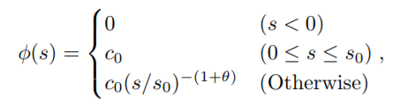
Part 3. Predicting Retweet Dynamics using Hawkes Process
How to run the example code
Then, where is the exciting kernel?
# additional parameters passed to infectious rate function
add_params = {'t0': start_time, 'bounds': [(-1, 0.5), (1, 20.)]}
obs_time = 48 # observation time of 2 days
pred_time = 168 # predict for one week
params, err, _ = estimate_parameters(events=events, obs_time=obs_time, **add_params)
The probability for getting a retweet in a small-time interval $\left[t,t+∆t\right]$ is $λ\left(t\right)∆t.$
Exciting kernel is fitted to the empirical data by the function where is the heavily tailed in a variety of social networks (Crane, et al. 2008, Masuda, et al. 2013)
$$λ\left(t\right)=p(t)\sum_{i:t_{i}<t}{d_{i}φ(t−t_{i})}$$
Exciting kernel
$c_{0}=6.49×{10}^{−4} seconds$
$s_{0}=300 seconds$
$θ=0.242$
Notes:
$p\left(t\right)$: infectious rate
$t_{i}$: the time of i-th retweet
$d_{i}$: followers of the i-th retweeting person
$φ\left(⋅\right)$: exciting kernel, a probability distribution for the time interval between a tweet by the followee and its retweet by the follower.

Slide 24
Part 3. Predicting Retweet Dynamics using Hawkes Process
We are going to estimate the exciting kernel from the dataset.
Then, where is the exciting kernel?
$c_{0}=6.49×{10}^{−4} seconds$
$s_{0}=300 seconds$
$θ=0.242$
Now, let’s estimate the kernel !
Notes:
$p\left(t\right)$: infectious rate
$t_{i}$: the time of i-th retweet
$d_{i}$: followers of the i-th retweeting person
$φ\left(⋅\right)$: exciting kernel, a probability distribution for the time interval between a tweet by the followee and its retweet by the follower.

